Slide 1
Hard Disk Drives
By: Iman Ahmed
Teacher: Mr. Nestor
Date: October 2

Slide 2
What is hard disk drive
A disk drive is a technology which enables the reading, writing, deleting and modifying of data on a computer storage disk.
The way it fits together with other components is that it has four key components inside its casing
The platter (for storing data).
The spindle (for spinning the platters), which is a mechanical device that takes energy, its usually created with air and electricity.
Read/write arm (for reading and writing data) and the actuator (for controlling the actions of the read/.

Slide 3
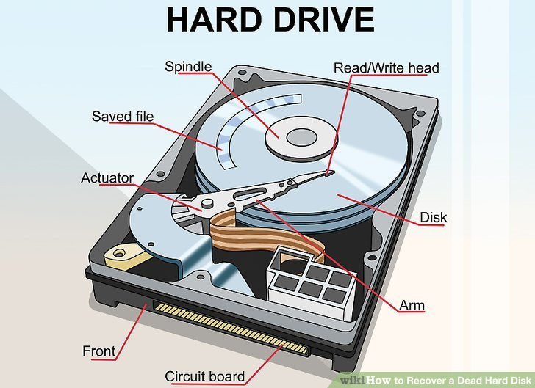
It is for spinning the platters.
Reading and writing data
It is where you put the disk.

